Slide 1
Nonlinear Equations II
Week 3
Dr. Michael R. Gustafson II, Duke University
All images copyright © The McGraw-Hill Companies, Inc. Permission required for reproduction or display.
Numerical Methods for Engineers and Scientists: An Introduction with Applications Using MATLAB by Amos Gilat and Vish Subramaniam.

Slide 2
Steps to solve problems
numerical schemes
algorithm
programs
results

Slide 3
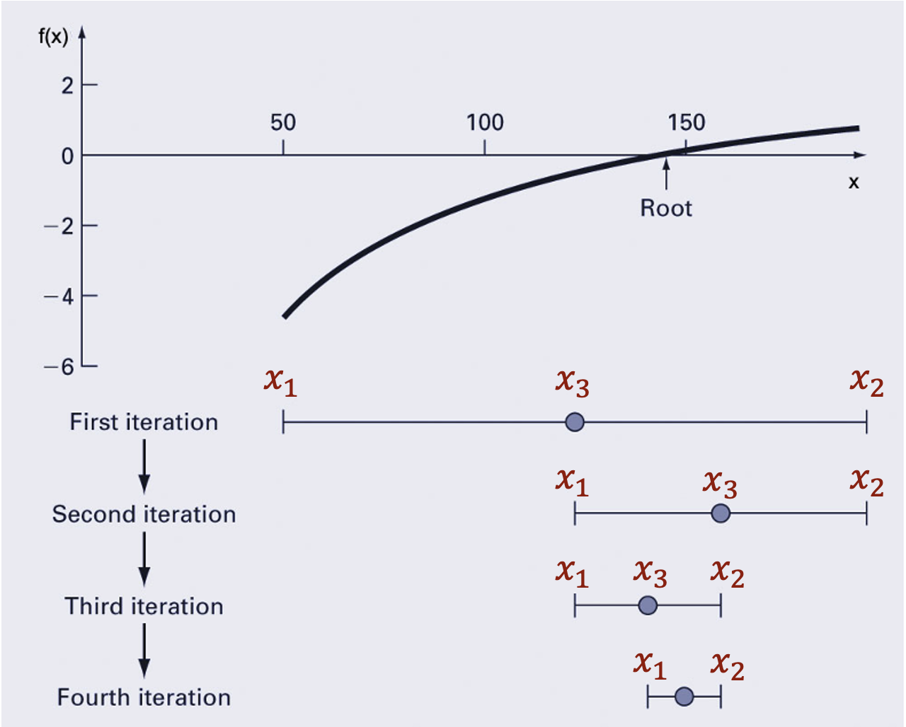
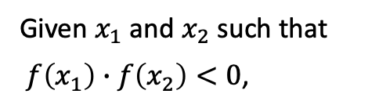


Bisection Method (Bracketing method)
Given $x_{1}$ and $x_{2}$ such that
$f\left(x_{1}\right)∙f\left(x_{2}\right)<0$,
Repeat
Set $x_{3}=\frac{1}{2}\left(x_{1}+x_{2}\right)$
If $f\left(x_{1}\right)∙f\left(x_{3}\right)<0$
Set $x_{2}=x_{3}$
Else
Set $x_{1}=x_{3}$
End if
Until ${(x}_{2}−x_{1})<TOL$

Slide 4
Programming Bisection
def F(x):
y = 8-4.5*(x-np.sin(x))
return y
x1, x2, imax, TOL = 1, 3, 30, 0.001
if F(x1)*F(x2)>0:
print('Error: The function has the same sign at points x1 and x2.')
else:
for i in range(imax):
x3 = (x1+x2)/2
toli = (x2+x1)/2
if F(x3) == 0:
print('An exact solution x = %.6f was found'%x3)
break
if toli<TOL:
break
if i==imax:
print('Solution was not obtained in %i iterations'%imax)
break
if F(x1)*F(x3)<0:
x2 = x3
else:
x1 = x3

Slide 5
if vs while
if
while
def f(x):
y = 8-4.5*(x-np.sin(x))
return y
a=1
b=3
for i in range(300):
c=(a+b)/2
if f(c)*f(a) < 0:
b=c
else:
a=c
if abs(a-b) < 10^(-6):
break
print(a)
print(b)
print(count)
def f(x):
y = 8-4.5*(x-np.sin(x))
return y
a=1
b=3
count=1
while abs(a-b) > 10^(-6):
c=(a+b)/2 ;
if f(c)*f(a) < 0:
b=c
else:
a=c
count+=1
print(a)
print(b)
print(count)

Slide 6
for loop
max=10
for i in range(20):
i
if(i==max):
break
max=10
for i in range(20):
i
i=max
Avoid assigning a value to the index variable within the loop statements. The for statement overrides any changes made to index within the loop.

Slide 7
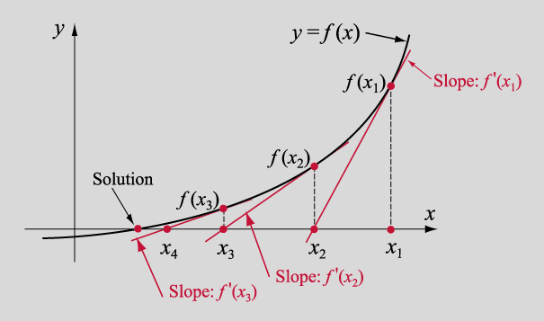




Newton Method (Open method)
Given $x_{0}$ reasonably close to the root,
Repeat
Compute $f\left(x_{0}\right), f′(x_{0})$
Set $x_{1}=x_{0}−\frac{f\left(x_{0}\right)}{f′(x_{0})}$
Until ${|x}_{0}−x_{1}|<TOL$

Slide 8

Any exceptions for Bisection and Newton method?

Slide 9
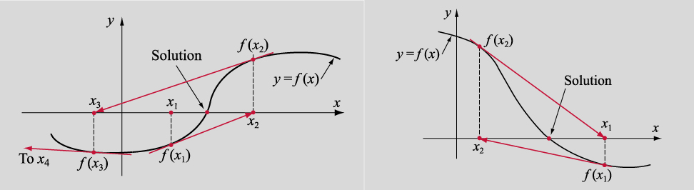
Some exceptions

Slide 10
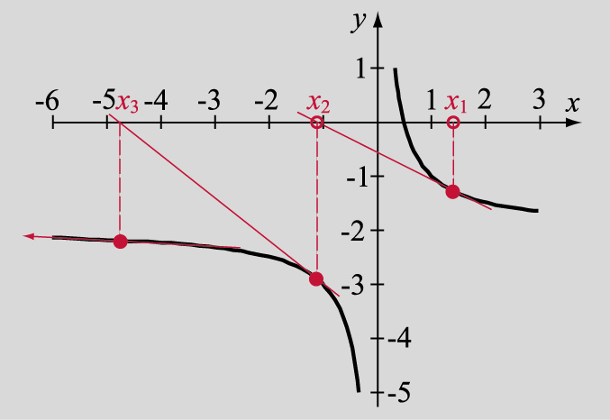
Figure 3-13a
Figure 2-13a

Slide 12

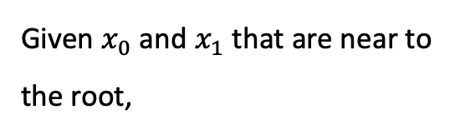

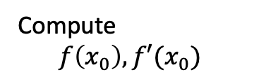
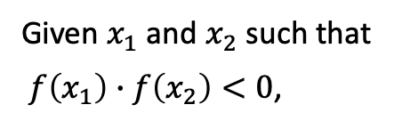


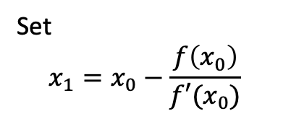
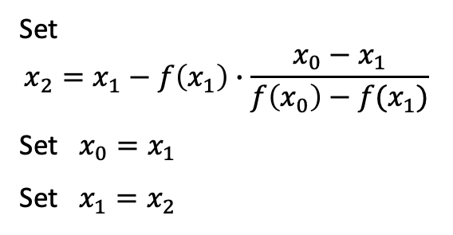

Secant method
Newton method
Bisection method
Given $x_{0}$ and $x_{1}$ that are near to the root,
Given $x_{0}$ reasonably close to the root,
Given $x_{1}$ and $x_{2}$ such that
$f\left(x_{1}\right)∙f\left(x_{2}\right)<0$,
Repeat
Repeat
Repeat
Set $x_{3}=\frac{1}{2}\left(x_{1}+x_{2}\right)$
If $f\left(x_{1}\right)∙f\left(x_{3}\right)<0$
Set $x_{2}=x_{3}$
Else
Set $x_{1}=x_{3}$
End if
Set $$x_{2}=x_{1}−f\left(x_{1}\right)∙\frac{x_{0}−x_{1}}{f\left(x_{0}\right)−f(x_{1})}$$
Set $x_{0}=x_{1}$
Set $x_{1}=x_{2}$
Compute $$f\left(x_{0}\right), f′(x_{0})$$
Set $$x_{1}=x_{0}−\frac{f\left(x_{0}\right)}{f′(x_{0})}$$
Until ${|x}_{0}−x_{1}|<TOL$
Until ${|x}_{0}−x_{1}|<TOL$
Until ${(x}_{2}−x_{1})<TOL$

Slide 13
Using ChatGPT?
ChatGPT: (https://www.dlc.ntu.edu.tw/ai-tools/)
『目前在學術寫作上，還沒有明確的 AI 生成內容的引用規則，但由於 AI 生成內容的資料來源是無法回溯、取得或提供直接連結的，因此建議將之視為 personal communication 或 correspondence，使用相對應的引用格式。細節和引用方法請查詢 APA、MLA、Chicago Manual Style 等各引用格式之規定，也可以參考 Scribbr 提供的引用建議和範例：ChatGPT Citations | Formats & Examples 。 』

